Slide 1
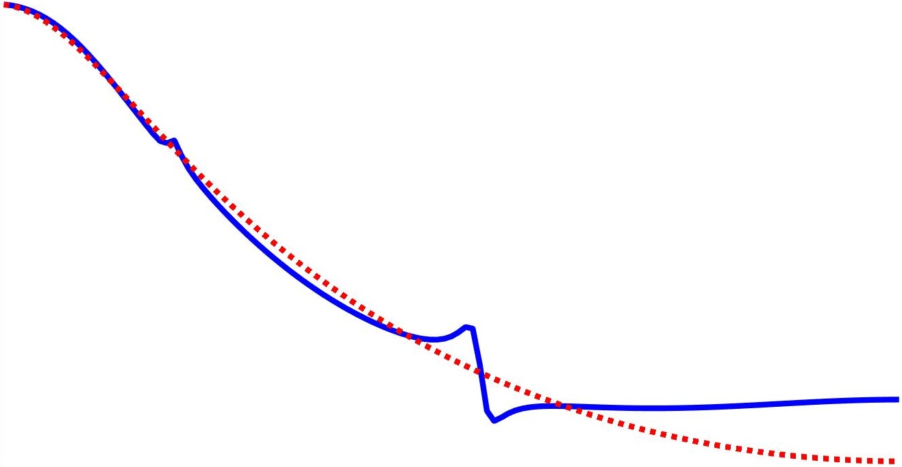
A frequency domain approach to data-driven control
Marc Berneman
With the supervision of Prof. Dr. Ir. Rik Pintelon
and the co-supervision of Prof. Dr. Ir. John Lataire

Slide 2
Table of contents
Motivation
Frequency domain approach
Model reference control
Simulations
Experiment
Conclusion
Contributions
References
Notes:
Data-driven: waarom is dit belangrijk?
Begin met introduction

Slide 3
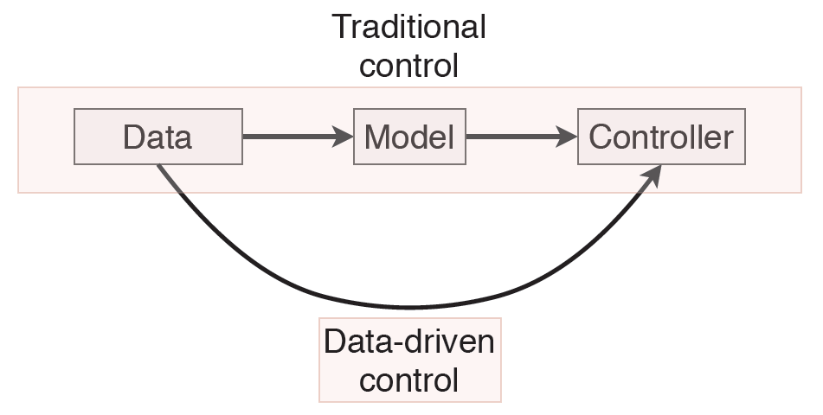
Motivation

Slide 4
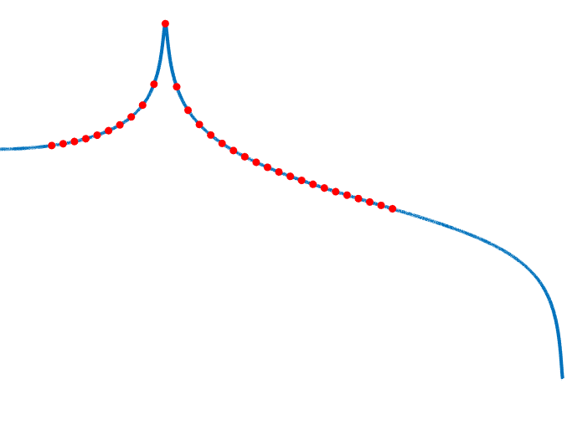
Frequency domain approach

Slide 5
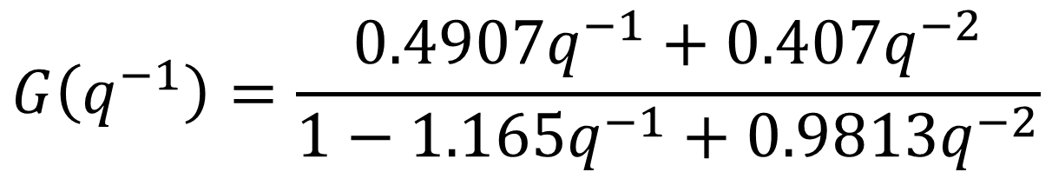
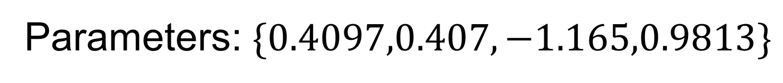
Frequency domain approach
Parametric model
$$G\left(q^{−1}\right)=\frac{{0.4907q}^{−1}+{0.407q}^{−2}}{1−1.165q^{−1}+0.9813q^{−2}}$$
Parameters: $\{0.4097,0.407,−1.165,0.9813\}$
Nonparametric model?

Slide 6
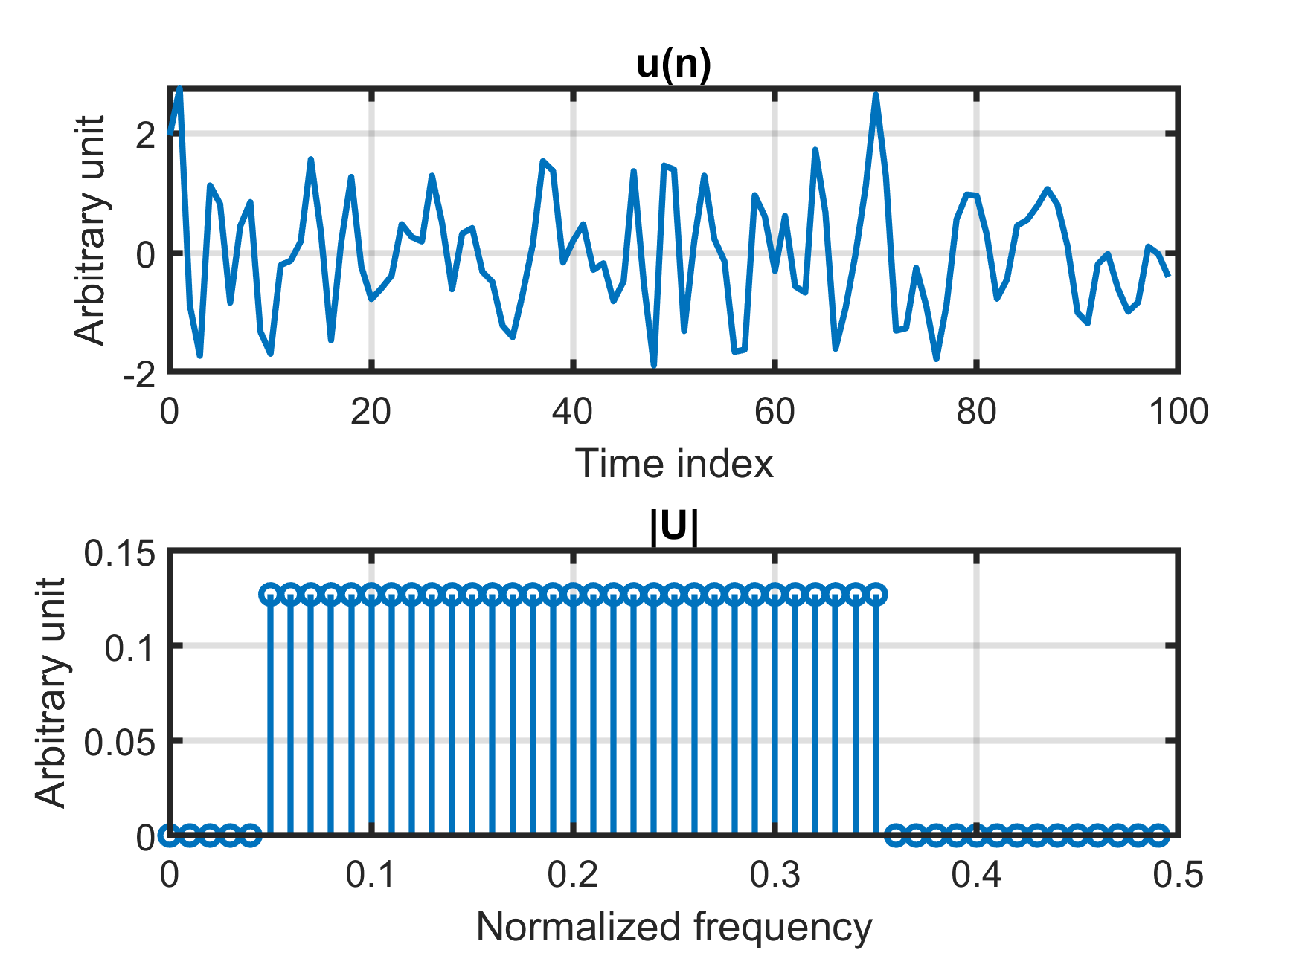
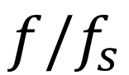
Frequency domain approach
$$f/f_{s}$$
Notes:
N = Time index
F/fs
A.U. voor y-as

Slide 7
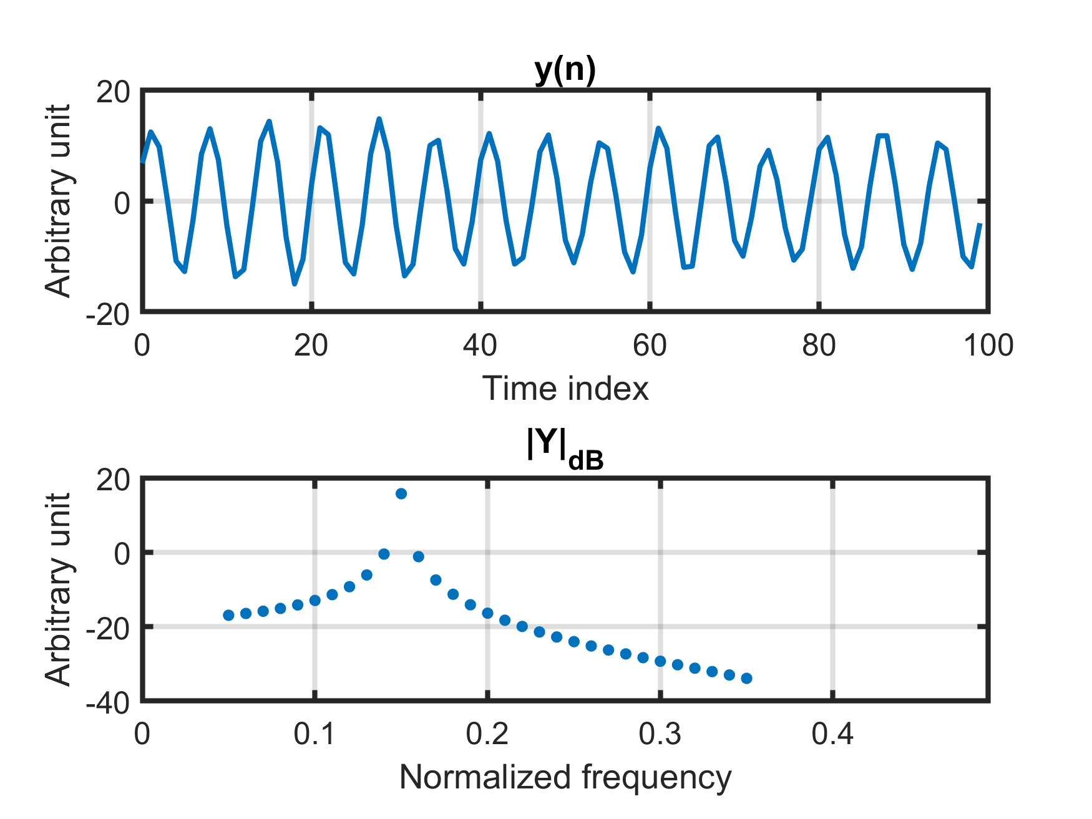
Frequency domain approach

Slide 8
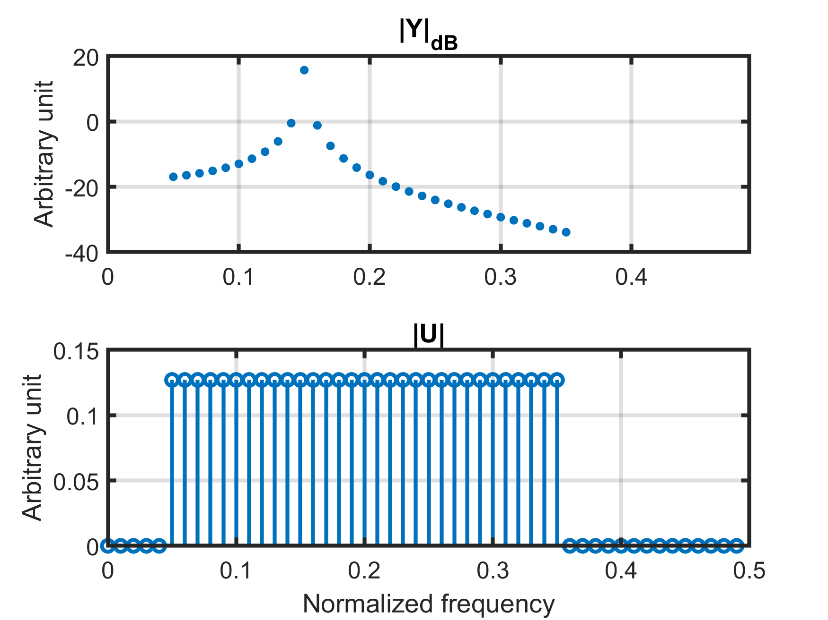
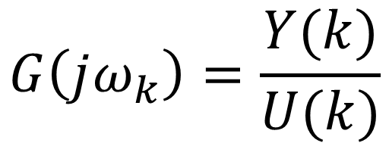
Frequency domain approach
$$G\left(jω_{k}\right)=\frac{Y(k)}{U(k)}$$

Slide 9
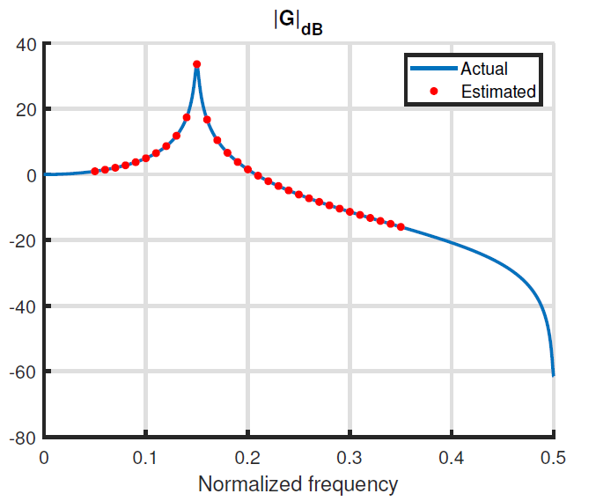
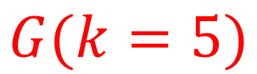
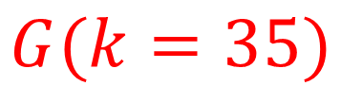
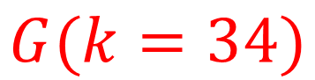
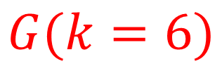
Frequency domain approach
$$G(k=34)$$
$$G(k=5)$$
$$G(k=35)$$
$$G(k=6)$$

Slide 10
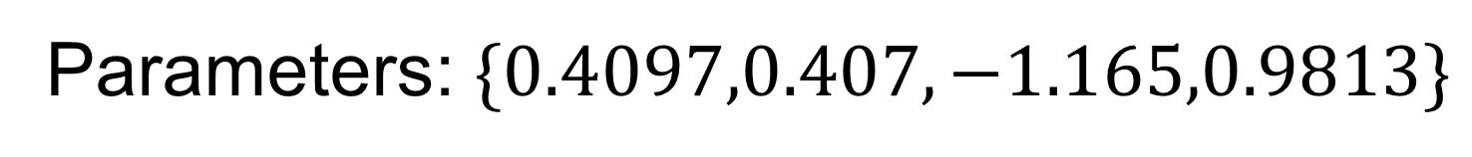
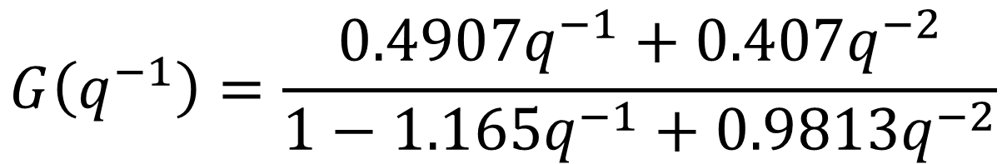
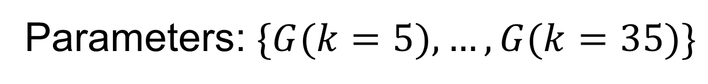
Frequency domain approach
Nonparametric model
Parameters: $\{G(k=5),…,G(k=35)\}$
Number of parameters can grow with the amount of data
Parametric model
$$G\left(q^{−1}\right)=\frac{{0.4907q}^{−1}+{0.407q}^{−2}}{1−1.165q^{−1}+0.9813q^{−2}}$$
Parameters: $\{0.4097,0.407,−1.165,0.9813\}$

Slide 11
Model reference control
Notes:
Dit naar begin

Slide 12
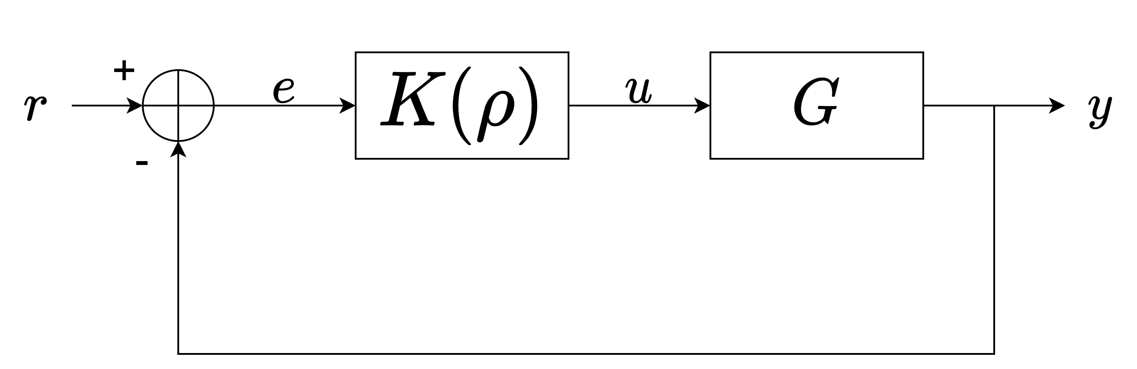
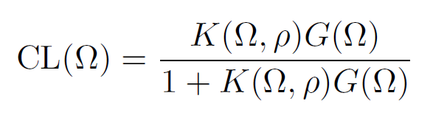
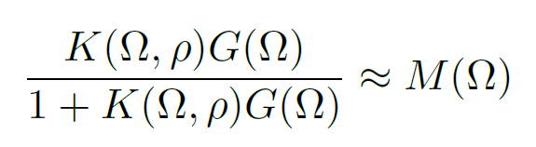
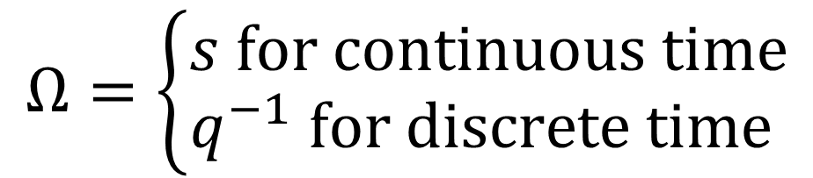
Model reference control
$$Ω=\left\{\begin{aligned}s for continuous time \\ q^{−1} for discrete time \end{aligned}\right.$$
User-defined reference model
“model reference control”
Notes:
Vereenvoudigen of meer tijd
Bewijs niet geven -> ik benader de sens functie ...

Slide 13
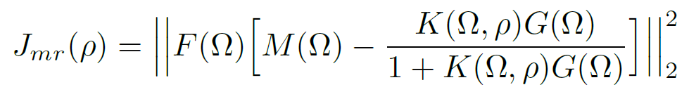
Model reference control
Weighing filter
Not convex ☹

Slide 14
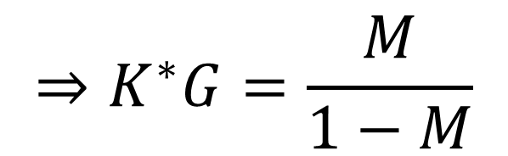
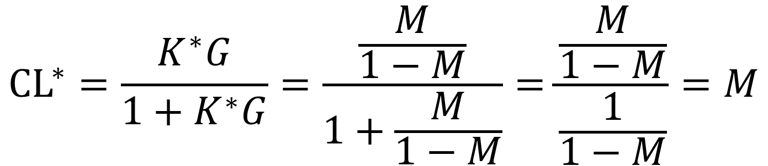
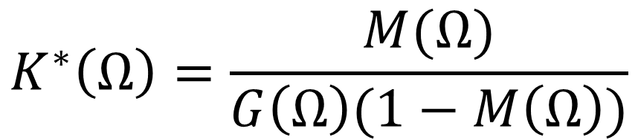
Model reference control
Ideal controller:
$$K^{∗}\left(Ω\right)=\frac{M(Ω)}{G\left(Ω\right)(1−M\left(Ω\right))}$$
$$⇒K^{∗}G=\frac{M}{1−M}$$
Ideal closed loop:
$$CL^{∗}=\frac{K^{∗}G}{1+K^{∗}G}=\frac{\frac{M}{1−M}}{1+\frac{M}{1−M}}=\frac{\frac{M}{1−M}}{\frac{1}{1−M}}=M$$

Slide 15
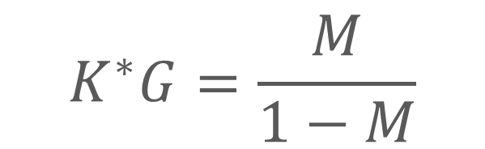
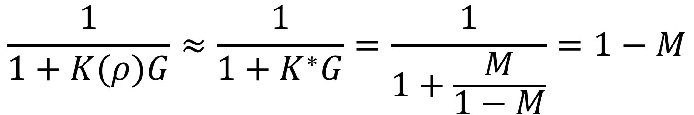
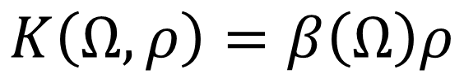
Model reference control
$$\frac{1}{1+K(ρ)G}≈\frac{1}{1+K^{∗}G}=\frac{1}{1+\frac{M}{1−M}}=1−M$$
$$K^{∗}G=\frac{M}{1−M}$$
$$J\left(ρ\right)={\left\|F\left(1−M\right)[M−\left(1−M\right)K\left(ρ\right)G]\right\|}_{2}^{2}$$
Convex ☺
Linear in the parameters:
$$K\left(Ω,ρ\right)=β\left(Ω\right)ρ$$

Slide 16
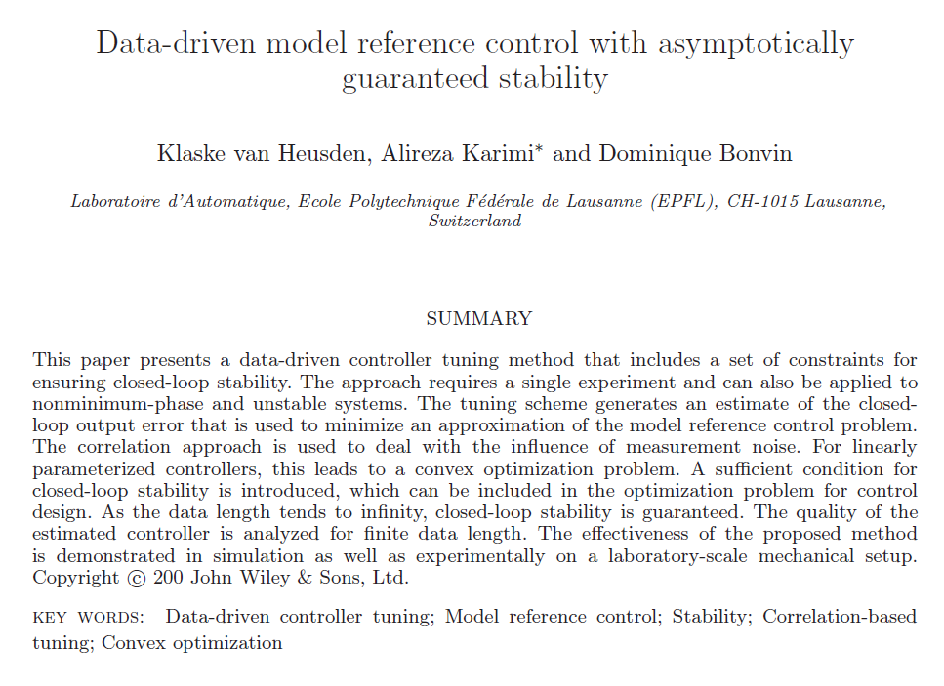
Model reference control
Ref. van Heusden et al. [2011]

Slide 17
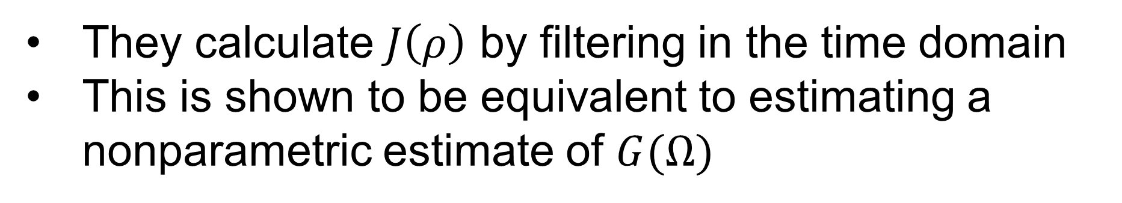
Model reference control
$$J\left(ρ\right)={\left\|F\left(1−M\right)[M−\left(1−M\right)K\left(ρ\right)G]\right\|}_{2}^{2}$$
They calculate $J\left(ρ\right)$ by filtering in the time domain
This is shown to be equivalent to estimating a nonparametric estimate of $G(Ω)$
Only possible for discrete time systems
Also possible for continuous time

Slide 18
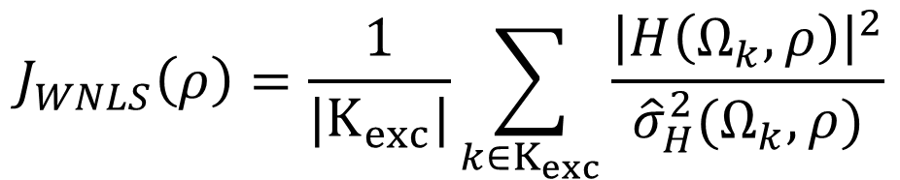
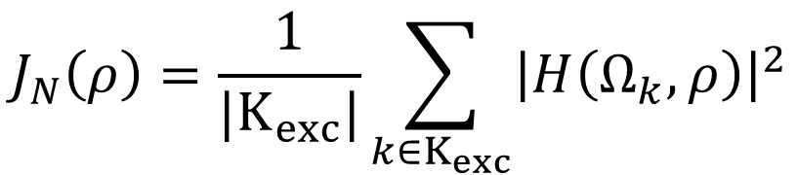
Model reference control
Time domain
Ref. van Heusden et al. [2011]
Frequency domain
$$H\left(Ω_{k},ρ\right)=F\left(Ω_{k}\right)\left(1−M\left(Ω_{k}\right)\right)[M\left(Ω_{k}\right)−\left(1−M\left(Ω_{k}\right)\right)K\left(Ω_{k},ρ\right)\hat{G}(Ω_{k})]$$
$$J_{N}\left(ρ\right)=\frac{1}{|K_{exc}|}\sum_{k∈K_{exc}}{{\left|H\left(Ω_{k},ρ\right)\right|}^{2}}$$
Biased
Excited harmonics
Weighted nonlinear least squares
$$J_{WNLS}\left(ρ\right)=\frac{1}{|K_{exc}|}\sum_{k∈K_{exc}}{\frac{{\left|H\left(Ω_{k},ρ\right)\right|}^{2}}{{\hat{σ}}_{H}^{2}(Ω_{k},ρ)}}$$
Removes noise-induced bias
Not convex ☹
Notes:
Why WNLS? No bias due to random noise

Slide 19

Simulations
Notes:
Hier nog een foto

Slide 20
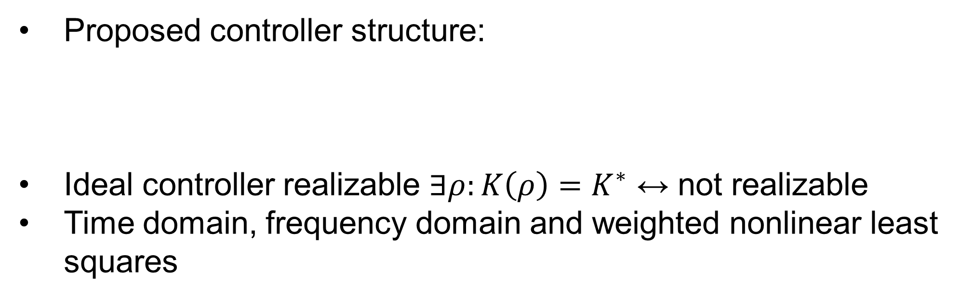
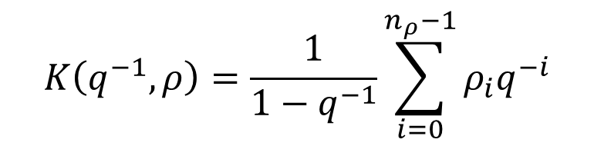
Simulations
Proposed controller structure:
Ideal controller realizable $∃ρ:K\left(ρ\right)=K^{∗}$ ↔ not realizable
Time domain, frequency domain and weighted nonlinear least squares
$$K\left(q^{−1},ρ\right)=\frac{1}{1−q^{−1}}\sum_{i=0}^{n_{ρ}−1}{ρ_{i}q^{−i}}$$
Linear in the parameters
Notes:
1 slide aan transient? Anders eerste zin weg

Slide 21
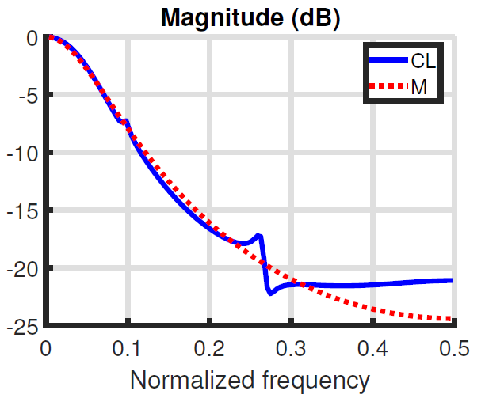
Simulations
Optimal closed loop (frequency domain) in the absence of noise
Ideal closed loop
Not realizable = “undermodelled”

Slide 22
Simulations
Method | Performance | Continuous time systems
Time domain | Best in general | ☹
Frequency domain | Comparable to time domain results. Sometimes attains better results. | ☺
Weighted nonlinear least squares | Very good when ideal controller is realizable. Not good in other cases. No guarantee of convergence | ☺

Slide 23
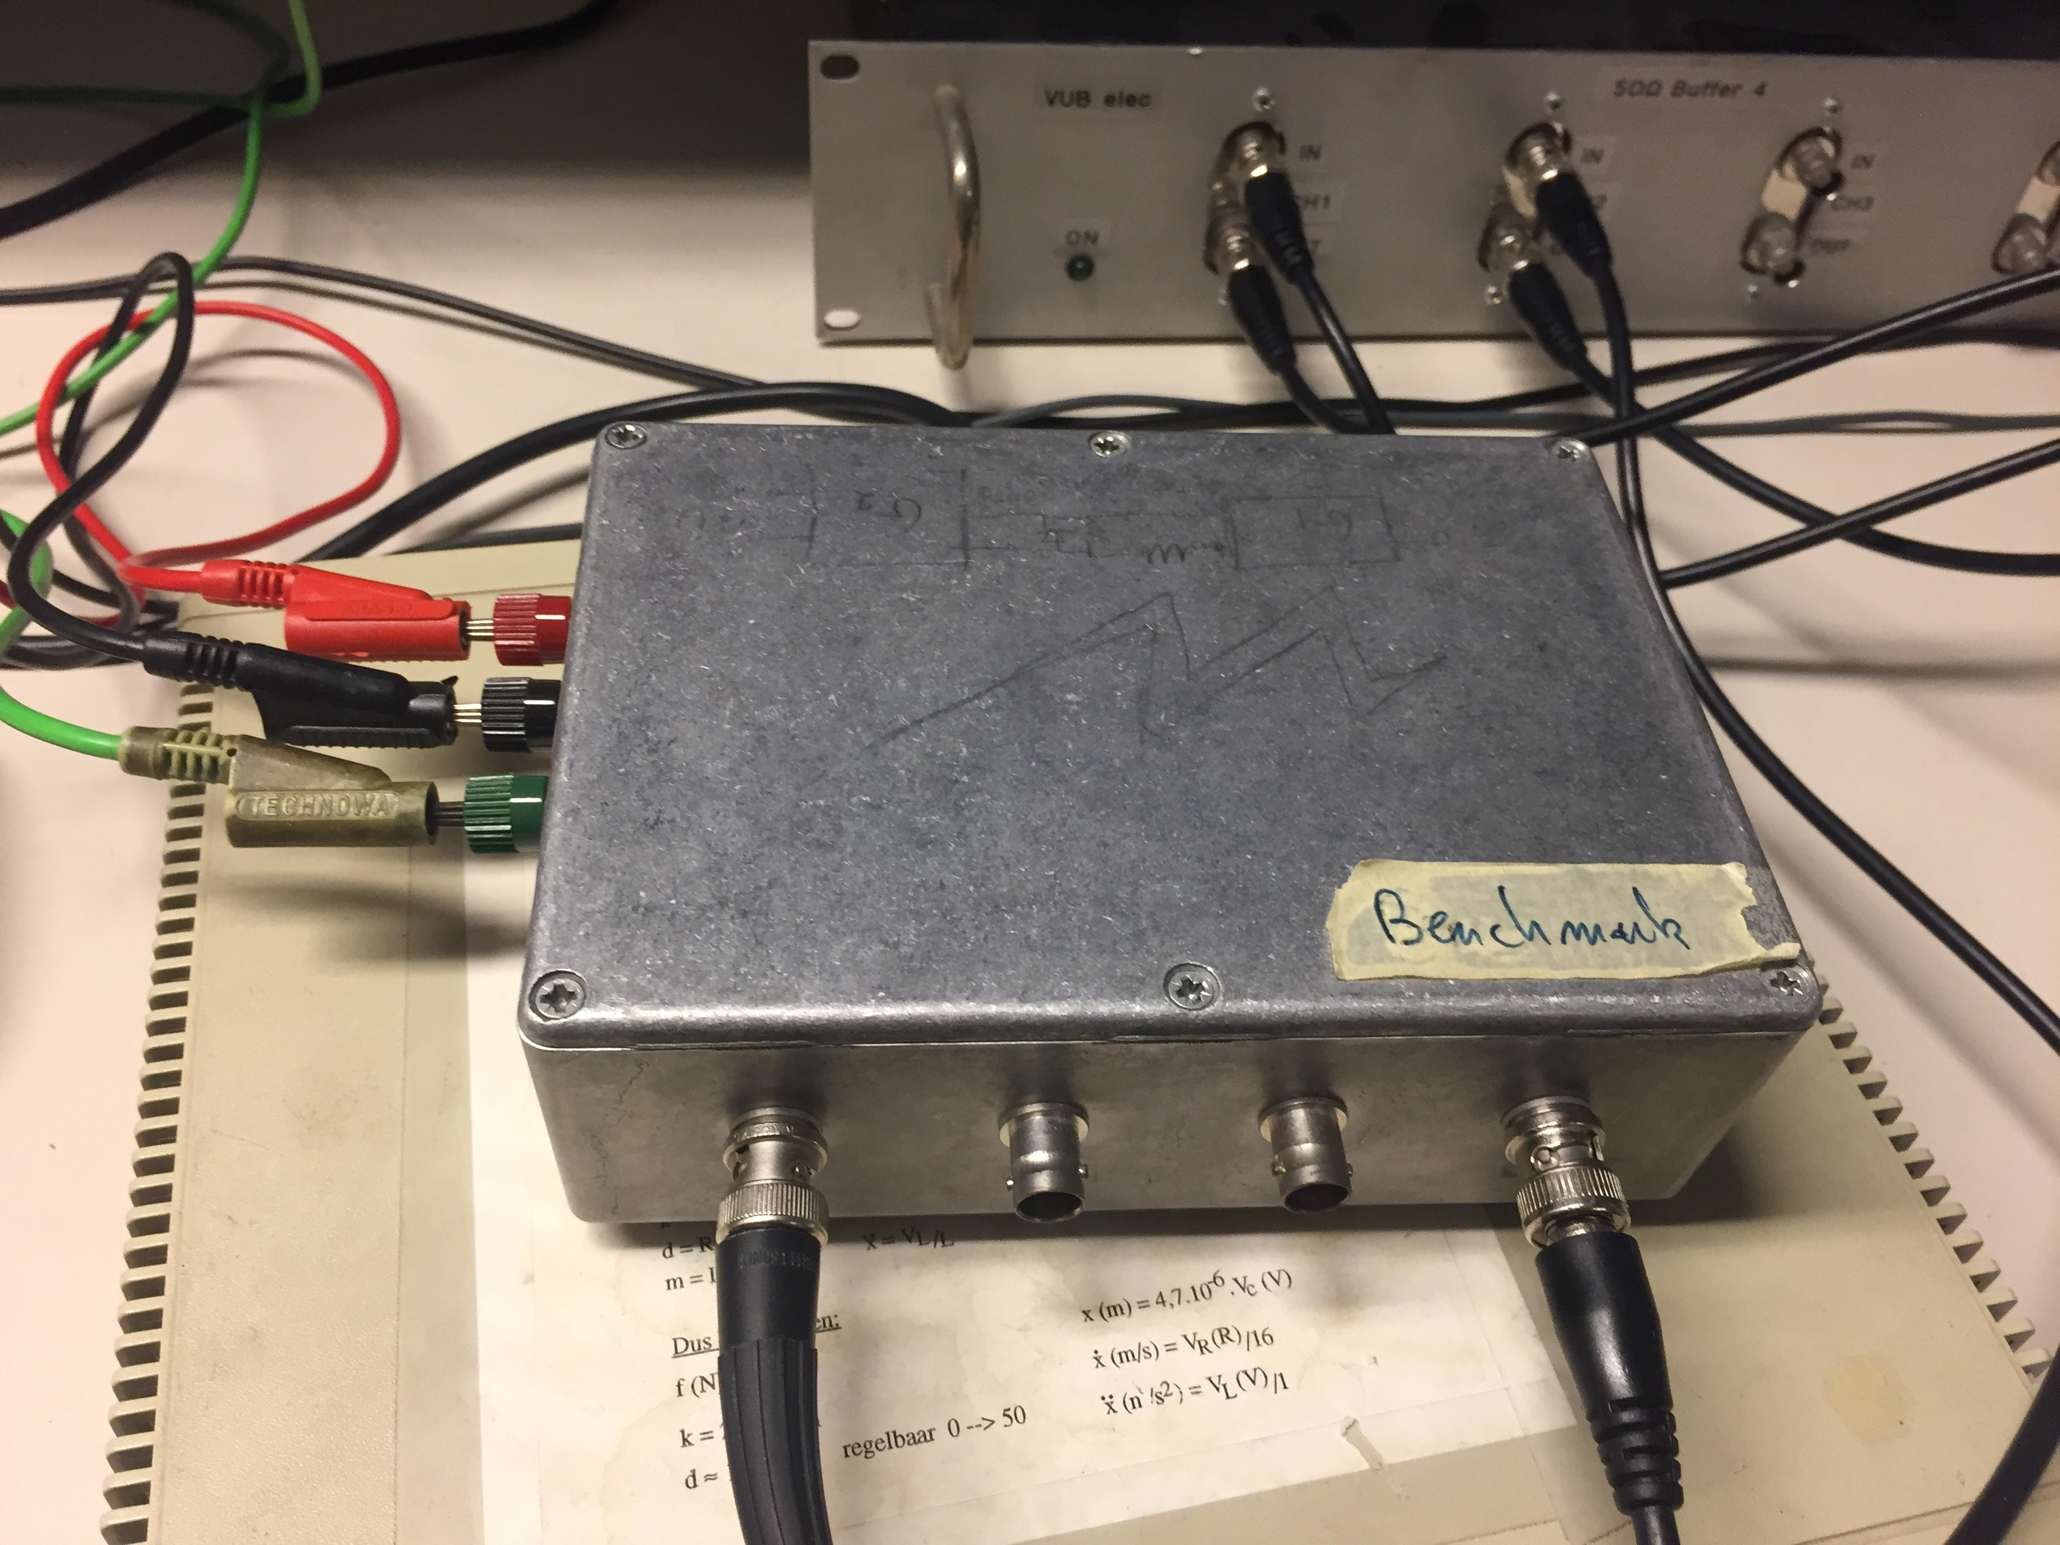
Experiment
Notes:
Blok schema van WH

Slide 24
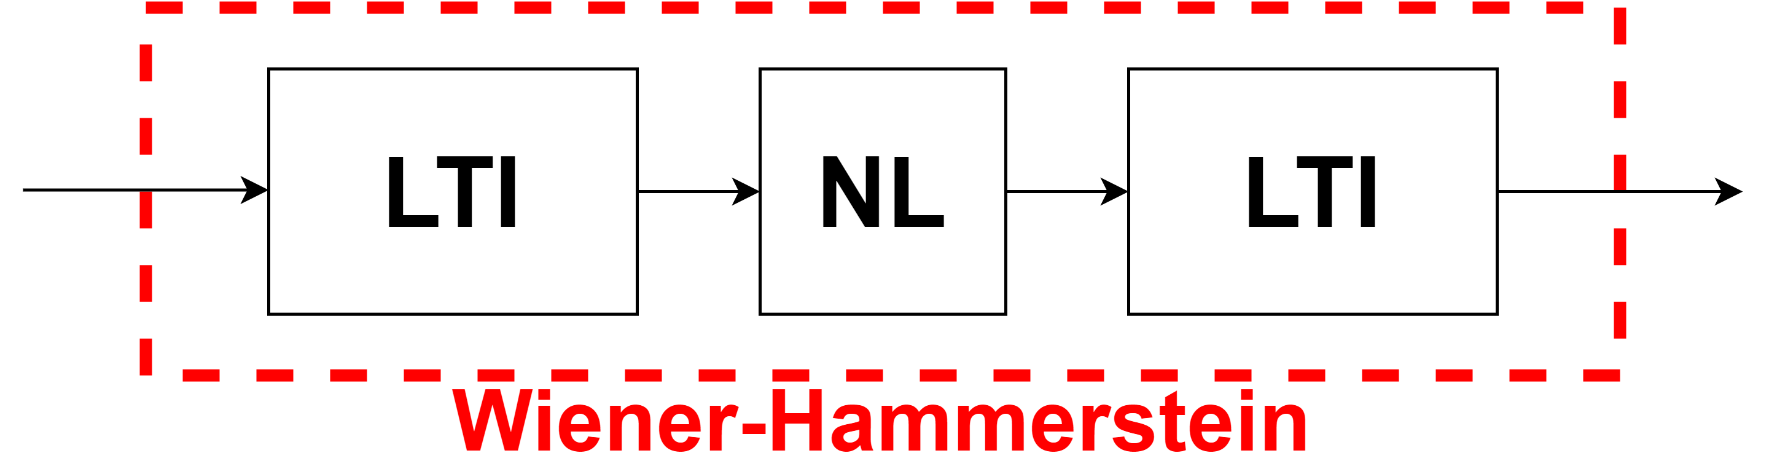
Experiment

Slide 25
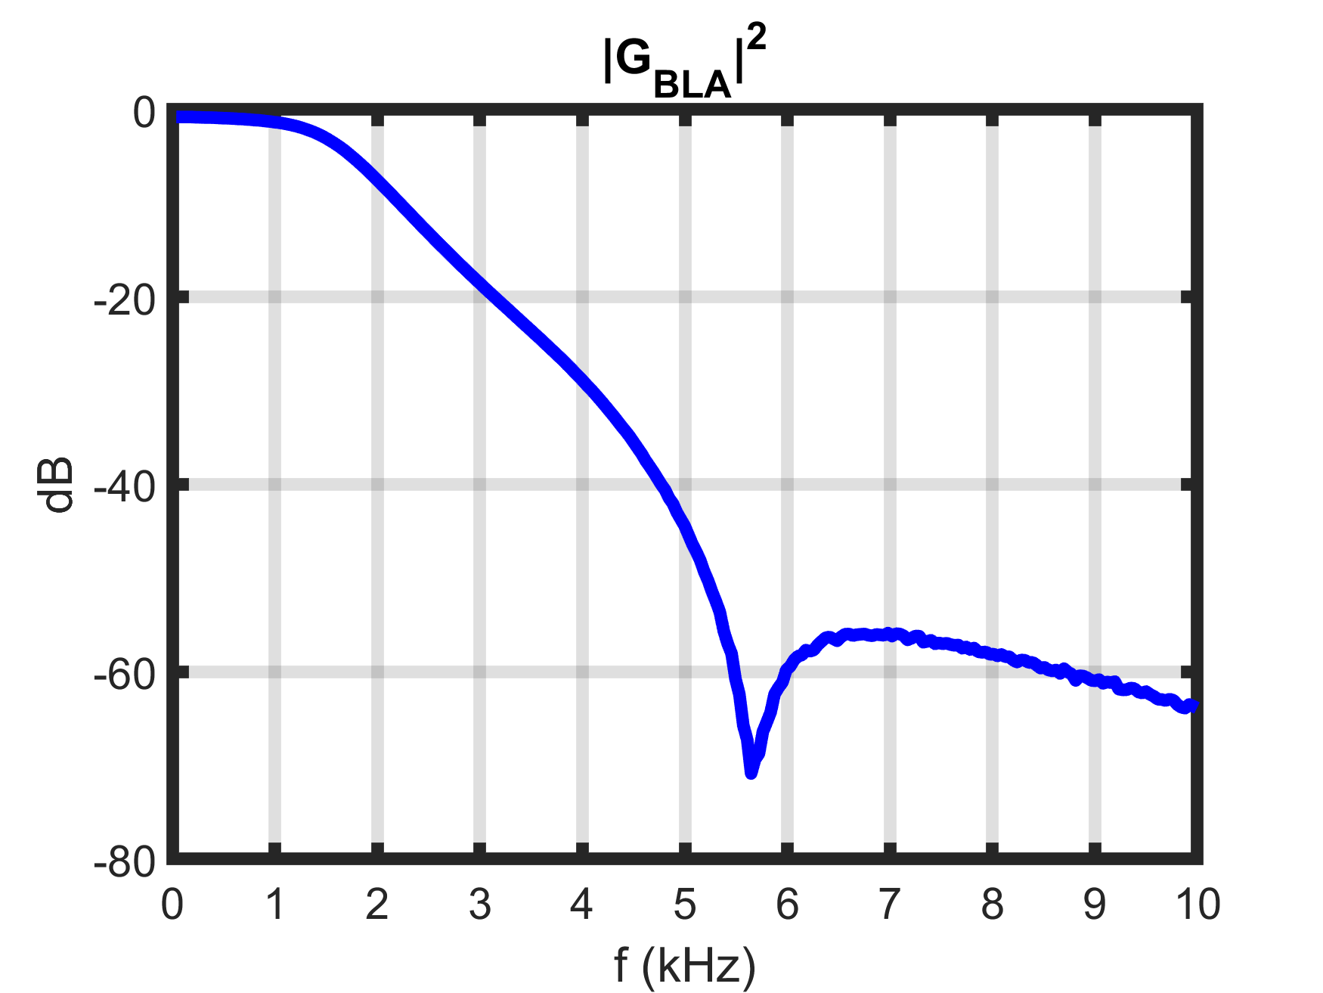
Experiment
Robust local polynomial method
Ref. Pintelon and Schoukens [2012]
Best linear approximation
Notes:
Varianties wegdoen

Slide 26
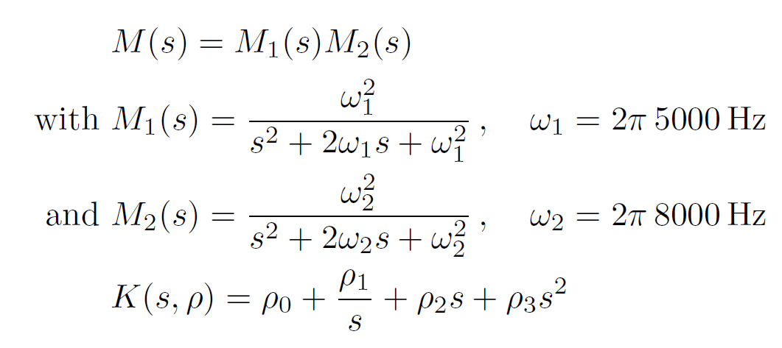
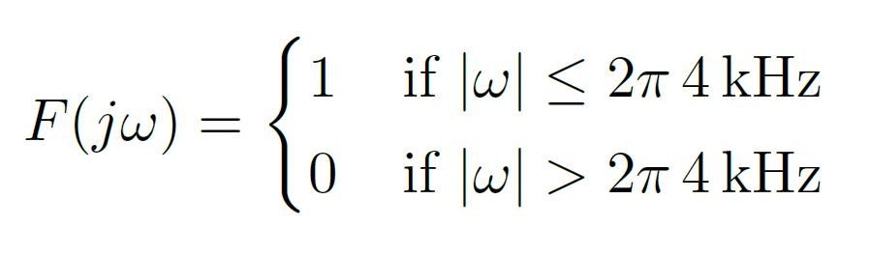
Experiment
PID

Slide 27
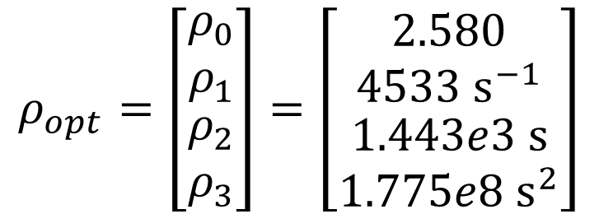
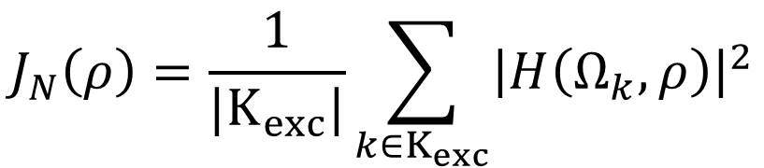
Experiment
$$H\left(Ω_{k},ρ\right)=F\left(Ω_{k}\right)\left(1−M\left(Ω_{k}\right)\right)[M\left(Ω_{k}\right)−\left(1−M\left(Ω_{k}\right)\right)K\left(Ω_{k},ρ\right)\hat{G}(Ω_{k})]$$
$$J_{N}\left(ρ\right)=\frac{1}{|K_{exc}|}\sum_{k∈K_{exc}}{{\left|H\left(Ω_{k},ρ\right)\right|}^{2}}$$
Minimize
$$ρ_{opt}=\left[\begin{matrix}ρ_{0} \\ ρ_{1} \\ \begin{aligned}ρ_{2} \\ ρ_{3}\end{aligned}\end{matrix}\right]=\left[\begin{matrix}2.580 \\ 4533 s^{−1} \\ \begin{aligned}1.443e3 s \\ 1.775e8 s^{2}\end{aligned}\end{matrix}\right]$$
P
I
D
D²

Slide 28
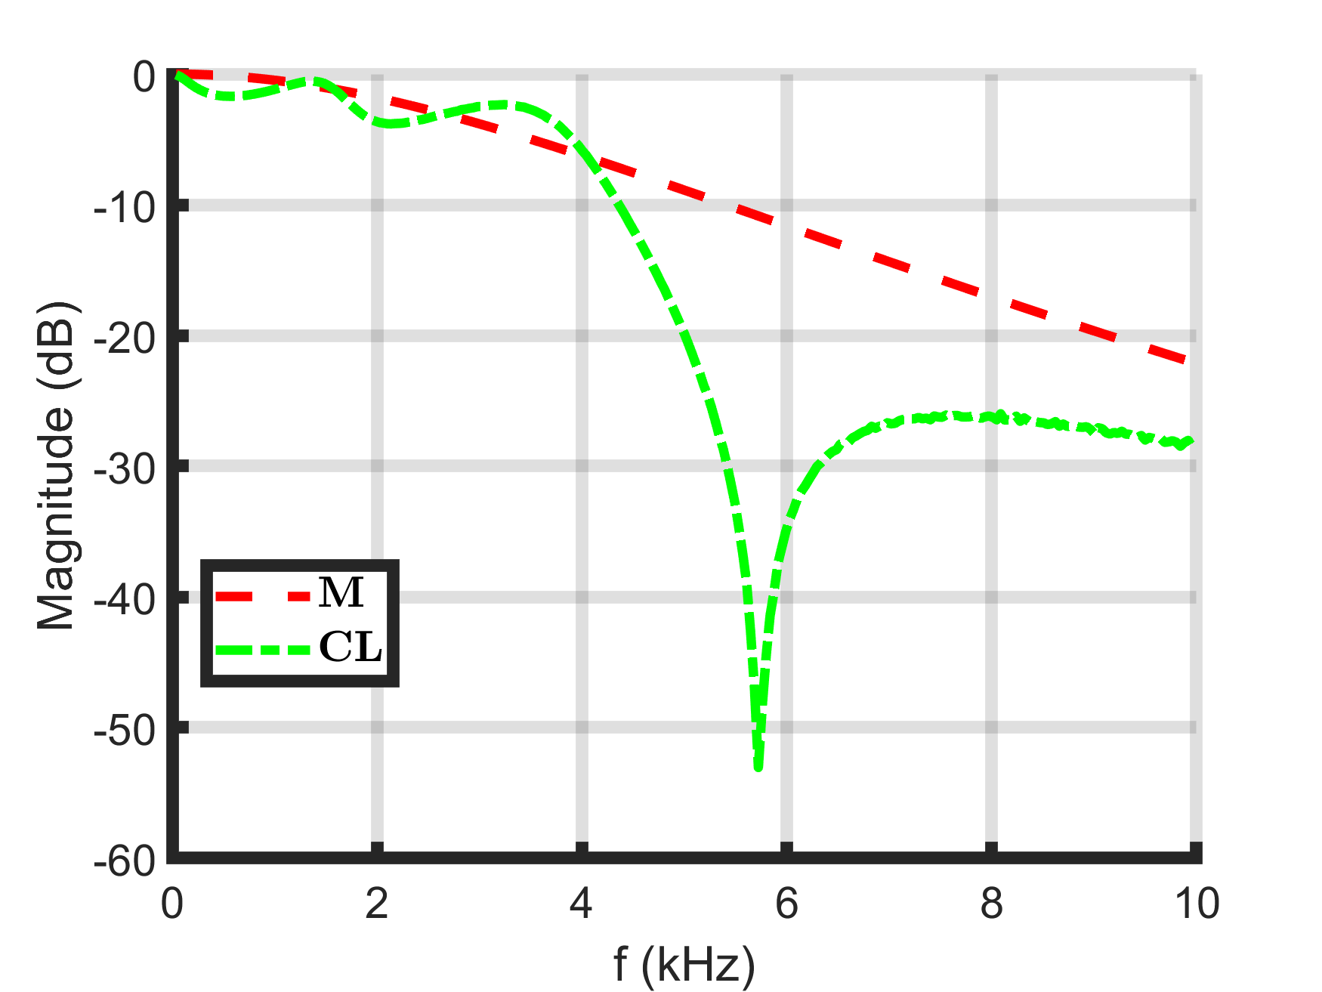
Experiment
Optimal closed loop
Ideal closed loop
Notes:
M-(1-M)Krho, GBLA wegdoen

Slide 29
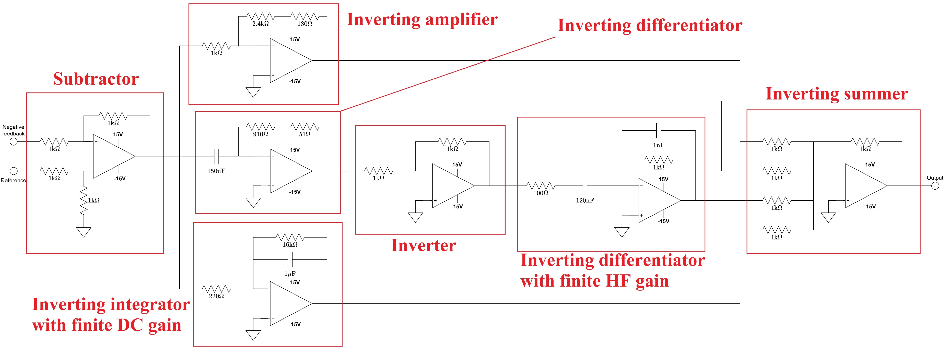
Experiment

Slide 30
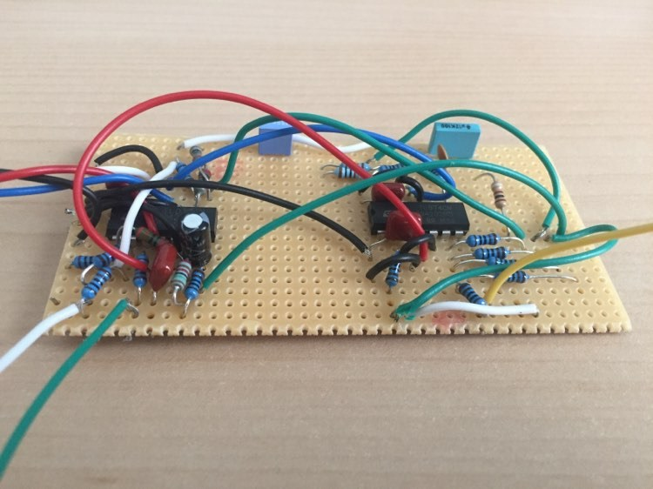
Experiment

Slide 31
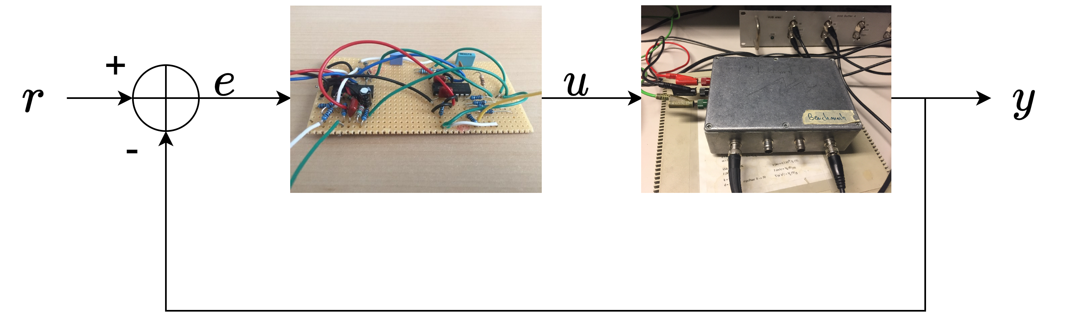
Experiment
Nonparametric measurement of the closed loop system
Reference (r) to output (y)

Slide 32
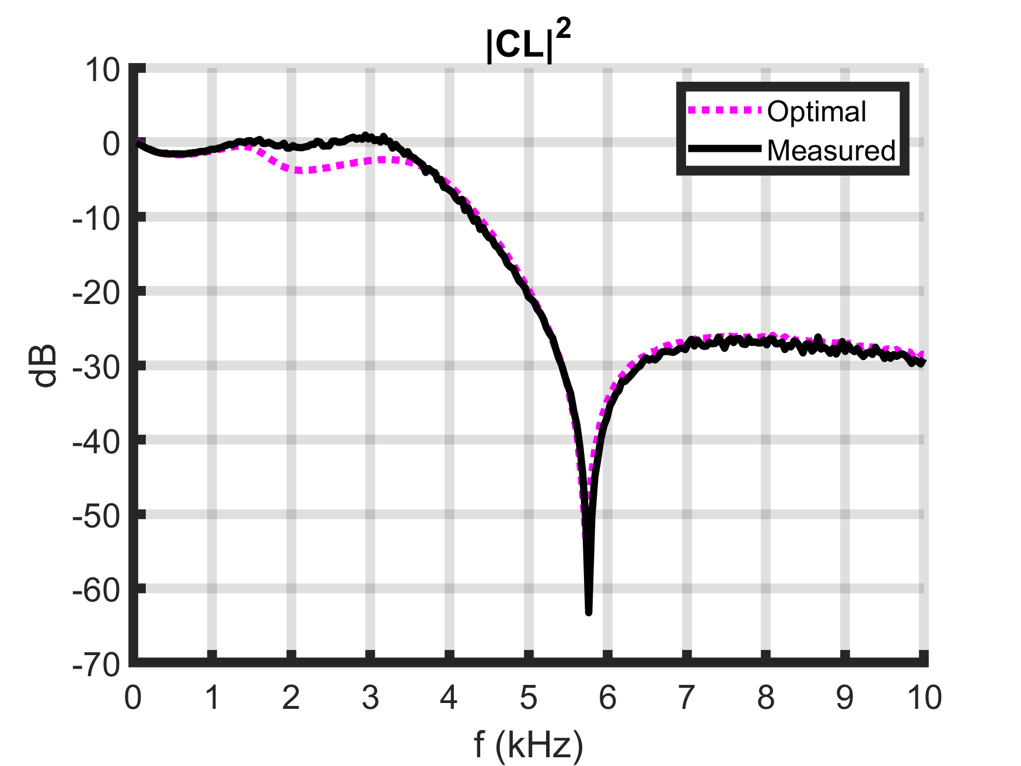
Experiment
Nonparametric measurement of the closed loop system ☺

Slide 33

Conclusion

Slide 34
Conclusion
Time domain method works better for discrete time systems
Frequency domain method also works for continuous time systems
Weighted nonlinear least squares method gives a big improvement if the ideal controller is realizable
Frequency domain method was successfully used to design an analog controller for a nonlinear system
Notes:
Data-driven -> niet parametrisch model

Slide 35


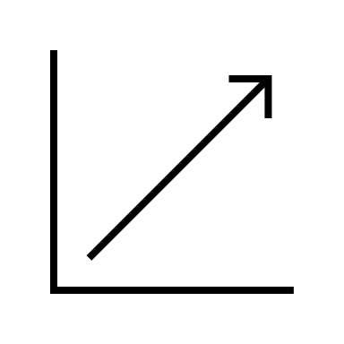
Contributions
I defined my own thesis and found the papers to get started and managed to implement them.
I found new ways to extend the ideas found in these papers
I used advanced frequency domain methods to suppress transients and nonlinearities

Slide 36



Contributions
I did a comprehensive comparison between all the methods in simulations
I measured a nonlinear systems and designed an analog controller for it
I also used the small-gain theorem to guarantee the stability of the closed loop system before soldering the controller.

Slide 37
References
van Heusden K, Karimi A, Bonvin D. Data-driven model reference control with asymptotically guaranteed stability. International Journal of Adaptive Control and Signal Processing. 2011;25(4):331{351. Available from: link [Accessed 26 August 2020].
Pintelon R, Schoukens J. System identification : a frequency domain approach. 2nd ed. Hoboken, N.J.: John Wiley & Sons Inc.; 2012.
Lataire, J., 2020. Frequency Domain Measurement And Identification Of Time-Varying Systems. (Slides) Available at: link [Accessed 26 August 2020].
MATLAB logo. Available at: link [Accessed 26 August 2020].

Slide 38
subsection

Slide 39
Title
Sample text
Sample text 2
Image caption

Slide 40
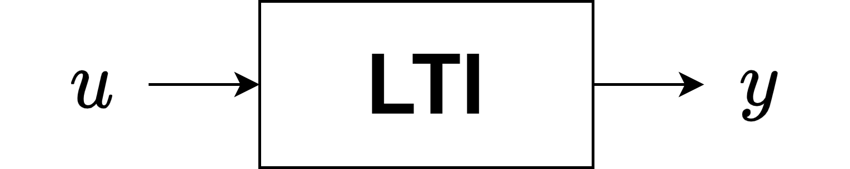
LTI systems

Slide 41


LTI systems
Single-input single-output
Linear Time-Invariant System
$$\left\{\begin{aligned}x\left(t+1\right)=Ax\left(t\right)+Bu(t) \\ y\left(t\right)=Cx\left(t\right)+Du(t)\end{aligned}\right.$$
$$Y\left(z\right)=G\left(z\right)U(z)$$
Transfer function
State space

Slide 42






LTI systems
Transfer function
State space
Discrete time
$$\left\{\begin{aligned}x\left(t+1\right)=Ax\left(t\right)+Bu(t) \\ y\left(t\right)=Cx\left(t\right)+Du(t)\end{aligned}\right.$$
$$Y\left(z\right)=G\left(z\right)U(z)$$
Continuous time
$$\left\{\begin{aligned}\dot{x}\left(t\right)=Ax\left(t\right)+Bu(t) \\ y\left(t\right)=Cx\left(t\right)+Du(t)\end{aligned}\right.$$
$$Y\left(s\right)=G\left(s\right)U(s)$$
$$G\left(Ω\right)$$
$$Ω=s,z$$
Model
$$(A,B,C,D)$$

Slide 43

LTI systems
Ref. Lataire [2017]

Slide 44

LTI systems
Ref. Lataire [2017]

Slide 45

LTI systems
Ref. Lataire [2017]

Slide 46

LTI systems
Multisine
Ref. Lataire [2017]

Slide 47

Discrete Fourier Transform

Slide 48
Discrete Fourier Transform
When does the DFT contain the same information as the Fourier Transform?

Slide 49

Discrete Fourier Transform
1. Nyquist-Shannon theorem

Slide 50

Discrete Fourier Transform
1. Nyquist-Shannon theorem

Slide 51

Discrete Fourier Transform
1. Nyquist-Shannon theorem

Slide 52
Discrete Fourier Transform
2. Periodicity
DFT assumes that the underlying signal is periodic for all time.

Slide 53

Discrete Fourier Transform
3. Leakage

Slide 54

Discrete Fourier Transform
3. Leakage

Slide 55

Discrete Fourier Transform
3. Leakage
The measurement time must contain an integer number of periods of the measured signal

Slide 56


Discrete Fourier Transform
1. Nyquist-Shannon theorem
2. Periodicity
3. Leakage
Fourier spectrum
DFT spectrum

Slide 57

Experiment
Nonparametric measurement of the controller in open loop ☹
Notes:
Open loop
Extra slide: waarom zou het zou falen? Wat beter volgende keer?

Slide 58

Experiment
Nonparametric measurement of the controller in open loop ☹
Saturation at output? No
Saturation at inner OPAMP? Possible
Lesson for next time:
Measure controller output in closed loop
Notes:
Open loop
Extra slide: waarom zou het zou falen? Wat beter volgende keer?

Slide 59



Experiment
$${\hat{K}}_{indirect}\left(jω_{k}\right)=\frac{\hat{CL}(jω_{k})}{{\hat{G}}_{BLA}(jω_{k})(1−\hat{CL}\left(jω_{k}\right))}$$
Indirect measurement of the controller ☺
$$\frac{0}{0}$$

